Slide 1
Evaluation of serum PVT1 biomarkers for predicting high grade prostate cancer
Tinovimba Hove¹, Olorunseun O. Ogunwobi^{2,} Emmanuel Asante-Asamani¹
¹ Clarkson University, Potsdam, NY; ² Michigan State University, East Lansing, MI
SIAM NNP Conference | Rochester Institute of Technology
November 2nd 2024
Page 1

Slide 2
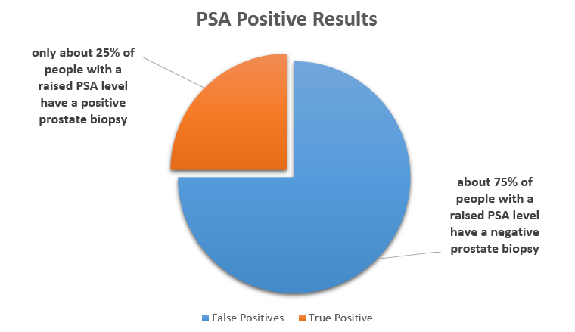
PCa is a leading cause of death by cancer in men
1 in 8 men will develop prostate cancer (PCa) in their lifetime. ¹
PCa is high grade (lethal) or low grade (non-lethal)
Current screening methods for PCa rely on prostate-specific antigen (PSA), a protein produced by the prostate gland that leaks into the bloodstream.
A PSA test measures the level of PSA in the blood. High PSA correlates with the presence of PCa (high sensitivity)
The Problem of PSA²
PSA leads to over-diagnosis and unnecessary biopsies (low specificity)
There is a critical need for new biomarkers that can improve the specificity of PSA
Page 2

Slide 3
Study Objective
Potential Solution
The Plasmacytoma variant translocation 1 (PVT1) is a long nonprotein coding gene associated with cancer progression.
PVT1 exons 4A, 4B, and 9 are over expressed in prostate tissues and human serum²
These specific exons could serve as valuable biomarkers for detecting prostate cancer.
Objective
This study evaluates the predictive power of PVT1 exons 4A, 4B, 9 in detecting PCa from human serum and improving the specificity of PSA
Page 3

Slide 4
Methods
Data Source
Copy numbers of PVT1 exons 4A, 4B,9, PSA from 144 multiracial men with elevated PSA.
Ogunwobi Lab at Michigan State University
Response & Explanatory Variables
Response Variable:
Pca Risk – High grade vs Not High Grade
Explanatory Variables: PSA, PVT1 Exon 4a, 4b, 9
Methods Overview
DATA LOADING & CLEANING
- Outlier Removal
- Normalization
DATA VISUALIZATION
- Boxplots
FEATURE SELECTION
- Z significance test
- Correlation Matrix
MODEL SELECTION
- - Likelihood Ratio Test
10-fold CV
- AUC
MODEL EVALUATION
- Multiple Logistic Regression
Page 4

Slide 5
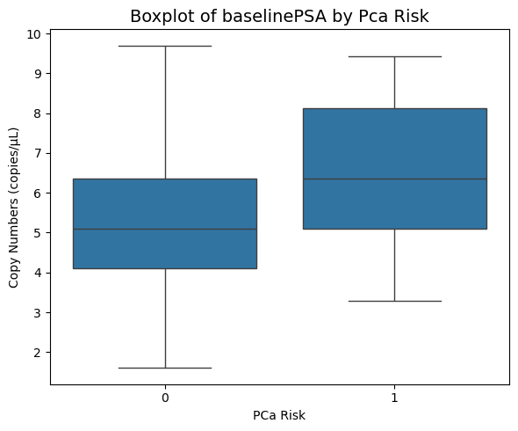
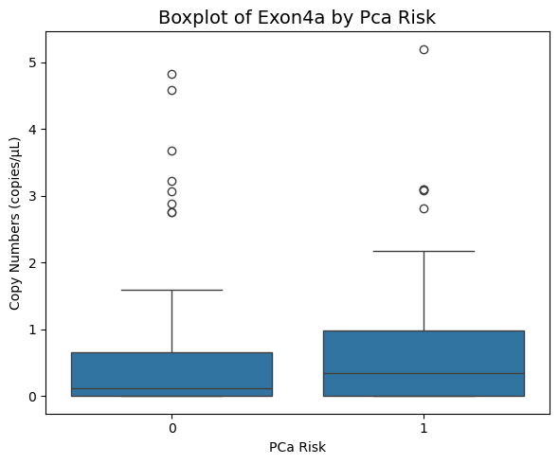
Data Visualization
Key
1 – High Grade
0 – Low Grade
P- value = 0.002 (Z-test @ 95% CI)
P- value = 0.221 (Z-test @ 95% CI)
Page 5

Slide 6
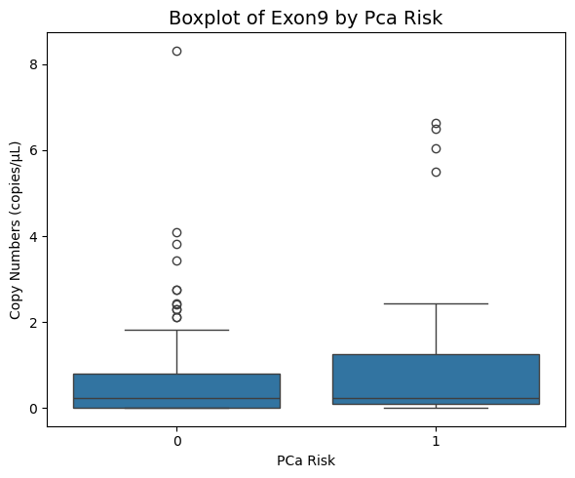
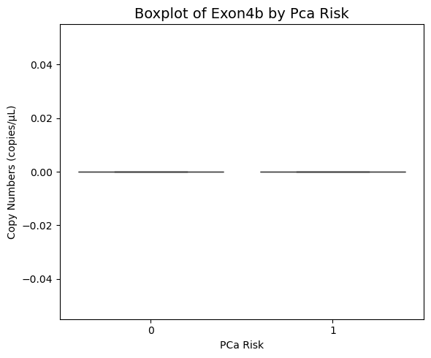
Data Visualization
Key
1 – High Grade
0 – Low Grade
P- value = 0.139 (Z-test @ 95% CI)
Page 6

Slide 7
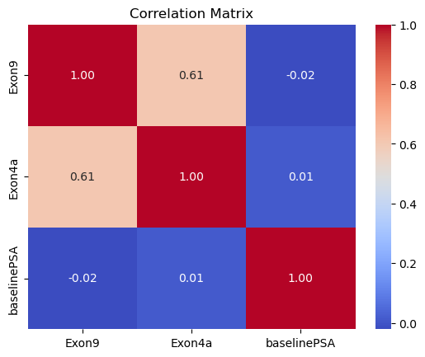
Correlation of Predictor Variables
Shows the relationships between three variables: Exon9, Exon4a, and baselinePSA
Red represents a strong positive correlation, and blue represents a weaker or negative correlation
Exon9 and Exon4a may have some relationship
Low correlations with baselinePSA
Page 7

Slide 8
Likelihood Ratio Test
Compare two nested models (one is a simpler version of the other)
Assess whether adding parameters significantly improves model fit
Comparison | P-value
PSA + Exon 9 vs. PSA Only | 0.010
PSA + Exon 4a vs. PSA Only | 0.006
PSA + Exon 9 + Exon 4a vs. PSA + Exon 9 | 1.000
PSA + Exon 9 + Exon 4a vs. PSA + Exon 4a | 1.000
Page 8

Slide 9

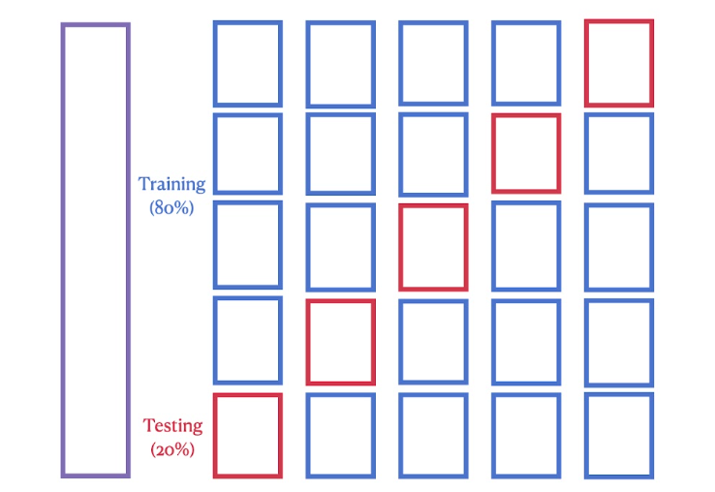
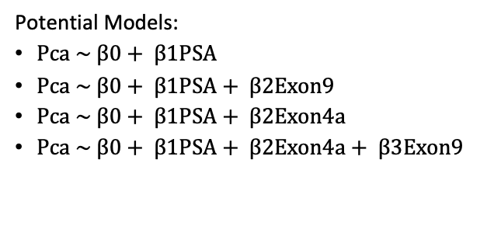
Cross Validation and Area Under Curve
Potential Models:
$Pca \sim β0+ β1PSA$
$Pca \sim β0+ β1PSA+ β2Exon9$
$Pca \sim β0+ β1PSA+ β2Exon4a$
$Pca \sim β0+ β1PSA+ β2Exon4a+ β3Exon9$
CV - technique used to assess the generalizability of a model by splitting the dataset into several parts or "folds.
10-fold cross validation
AUC metric for evaluation across all possible threshold values for classification
Page 9

Slide 10
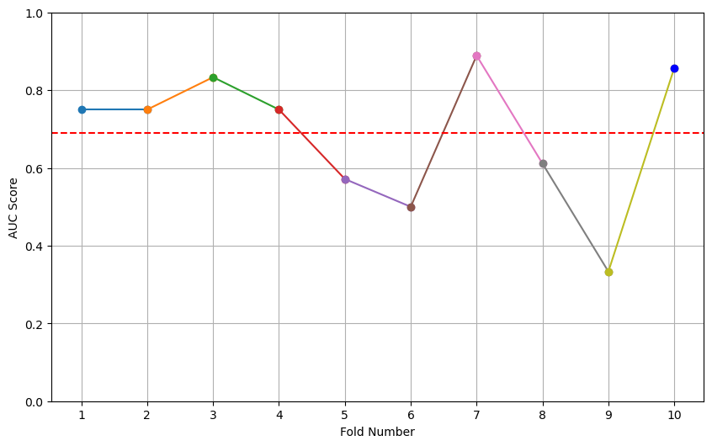
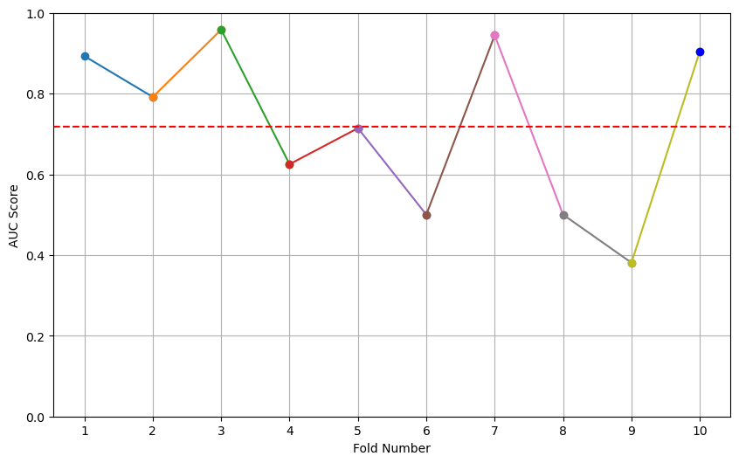
Model: [PSA]
Mean AUC = 0.69
Model: [PSA, Exon9]
Mean AUC = 0.718
Page 10

Slide 11
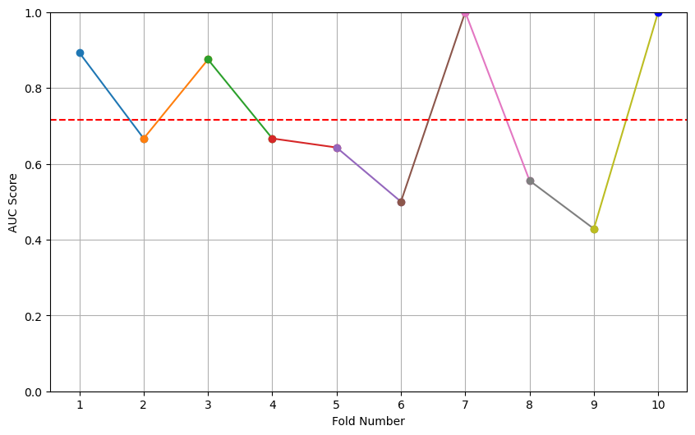
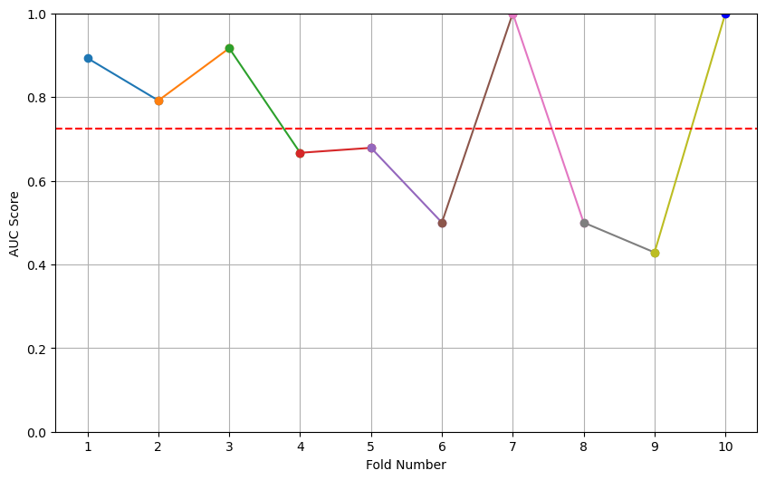
Model: [PSA, Exon4a]
Mean AUC = 0.716
Model: [PSA, Exon4a, Exon9]
Mean AUC = 0.725
Page 11
Notes:
Cross-validation helps establish the reliability and generalizability of the model.

Slide 12
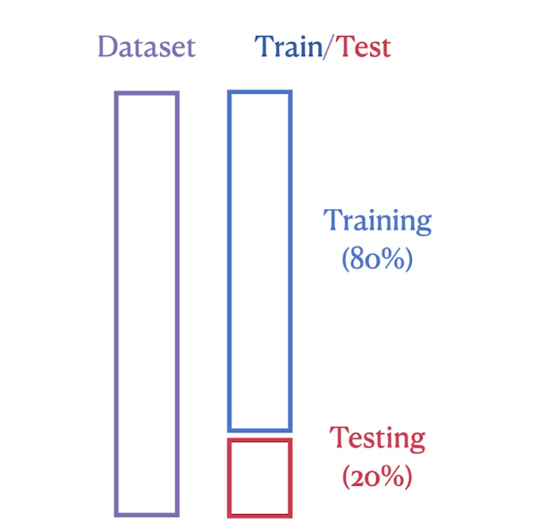
Multiple Logistic Regression
Train-Test Split
Logistic Regression
MLR models developed to evaluate the potential models
MLR technique used for binary classification to predict the probability P(Y=1∣X) that the target variable Y is 1 or 0 given the features X
Z = β0​ + β1​X1​ + β2​X2​ + ⋯ + βn​Xn​
β0 is the intercept (bias term),
β1, β2, …, βn​ are the coefficients
X1, X2, …, Xn are the independent variables (features).
sigmoid function σ(x, maps any real-valued number to a range between 0 and 1, making it suitable for probability estimation.
Threshold value calculated from Youden’s index
Page 12
Notes:
Multiple logistic regression then allows for more accurate, multi-faceted modeling of complex relationships between variables.

Slide 13
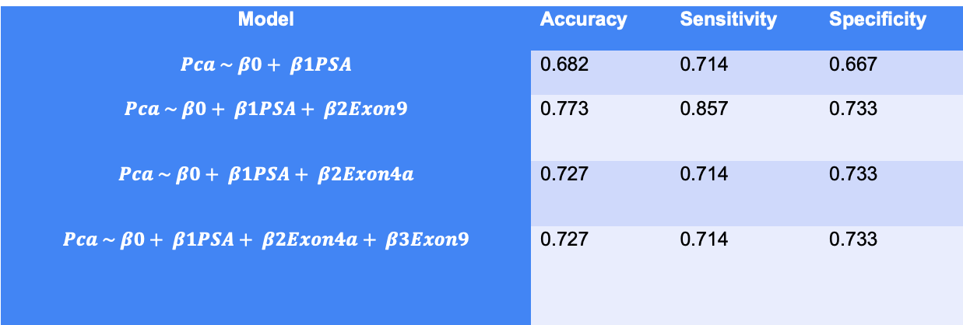
Multiple Logistic Regression Results
Model | Accuracy | Sensitivity | Specificity
$$Pca \sim β0+ β1PSA$$ | 0.682 | 0.714 | 0.667
$$Pca \sim β0+ β1PSA+ β2Exon9$$ | 0.773 | 0.857 | 0.733
$$Pca \sim β0+ β1PSA+ β2Exon4a$$ | 0.727 | 0.714 | 0.733
$$Pca \sim β0+ β1PSA+ β2Exon4a+ β3Exon9$$ | 0.727 | 0.714 | 0.733
Train-Test Split (80% - 20%), 0.3 threshold from Youden’s index
Page 13

Slide 14
Results Discussion & Future Work
Practical Reliability, Use, & Limitations
PVT1 biomarkers can help improve PCa detection and management.
Addition of PVT1 exons 4A or 9 improves the predictive accuracy of PSA in predicting the risk of high grade PCa
A model with PSA combined with PVT1 exon 9 gives the best predictive accuracy of PCa
Future Scope
Investigate the performance of PVT1 biomarkers among different racial populations.
Assessing the predictive performance of Support Vector Machines in predicting high grade PCa.
Page 14

Slide 15
Citations
¹ Siegel RL, Miller KD, Wagle NS, Jemal A. Cancer statistics, 2023. CA Cancer J Clin. 2023; 73(1): 17-48.
² Saini, S., 2016. PSA and beyond: alternative prostate cancer biomarkers. Cellular Oncology, 39, pp.97-106.
³ Pal, G. and Ogunwobi, O.O., 2019. Copy number-based quantification assay for non-invasive detection of PVT1-derived transcripts. PLoS One, 14(12), p.e0226620.
⁴ Ilboudo, A., Chouhan, J., McNeil, B.K., Osborne, J.R. and Ogunwobi, O.O., 2016. PVT1 exon 9: a potential biomarker of aggressive prostate cancer?. International journal of environmental research and public health, 13(1), p.12.
Page 15

Slide 16
Questions?
Thank you for listening.
Page 16

